Slide 1
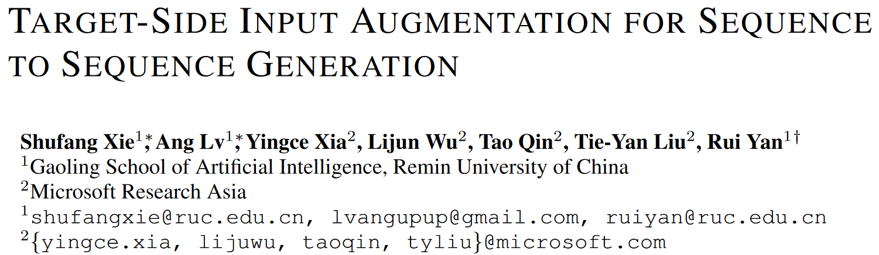
ICLR 2022

Slide 2
Introduction
In auto-regressive seq generation, each token is generated based on 2 kinds of input: the original source input and previous generated target-side tokens.
Most existing data augmentation works focus on enhancing source inputs, but the augmentation of target-side inputs is under-explored
This work focuses on target-side data augmentation.

Slide 3
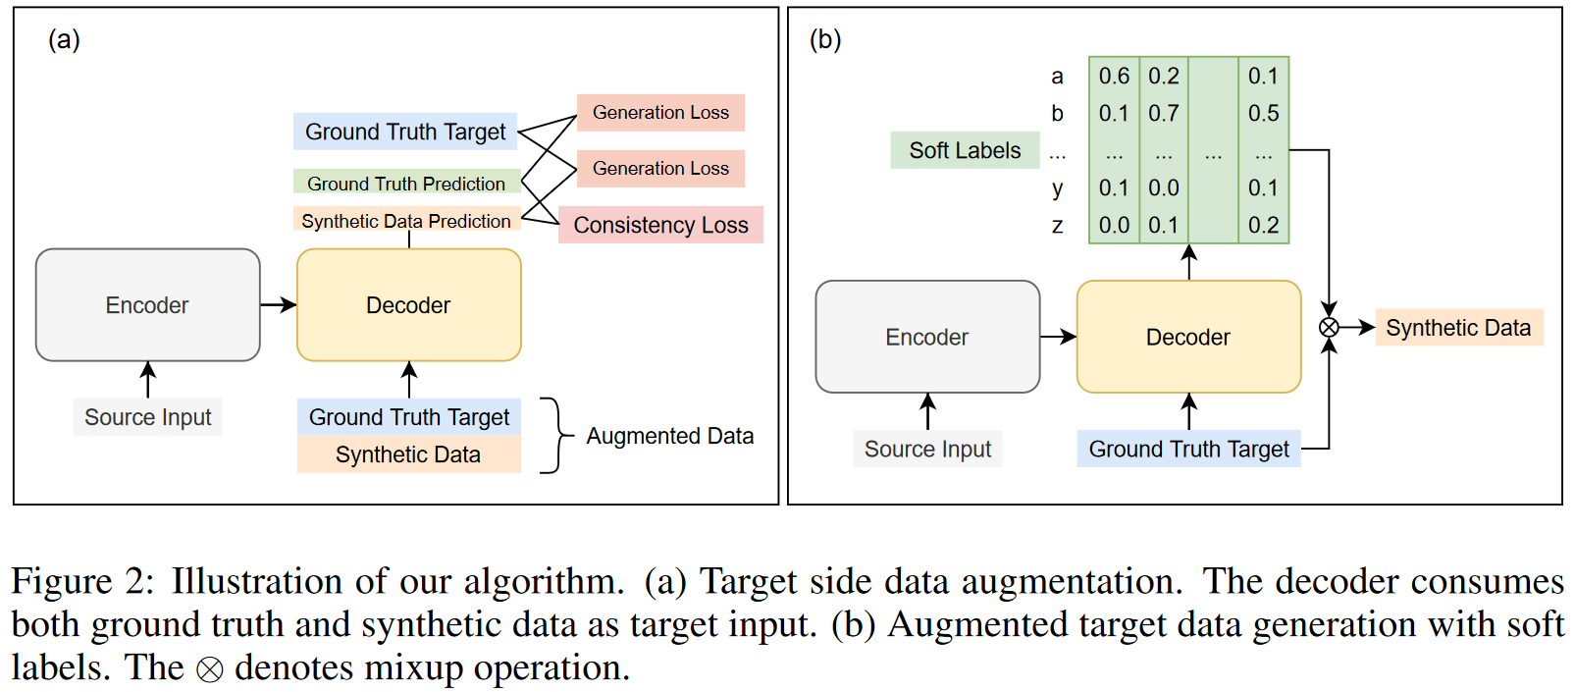
Method
${\breve{y}}_{j}=γP\left(⋅|x,y_{<j}\right)+\left(1−γ\right)y_{j},$^{one parameter} $T$ ^{is omitted here} $$ℒ=α\log{P\left(y_{j}|x,{\breve{y}}_{<j}\right)}+\left(1−α\right)\log{P\left(y_{j}|x,y_{<j}\right)}+β𝒟\left(P\left(⋅|x,y_{<j}\right),P\left(⋅|x,{\breve{y}}_{<j}\right)\right).$$

Slide 4
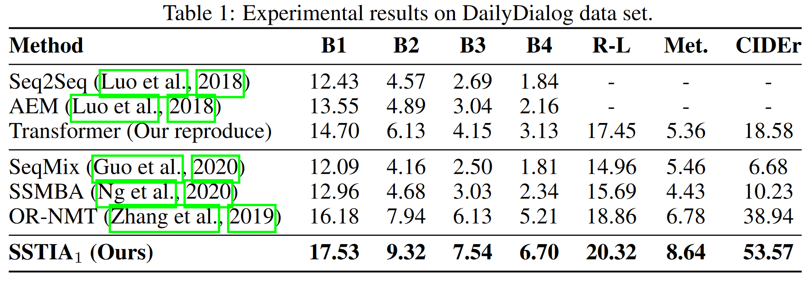
Experiments - Dialog Generation

Slide 5
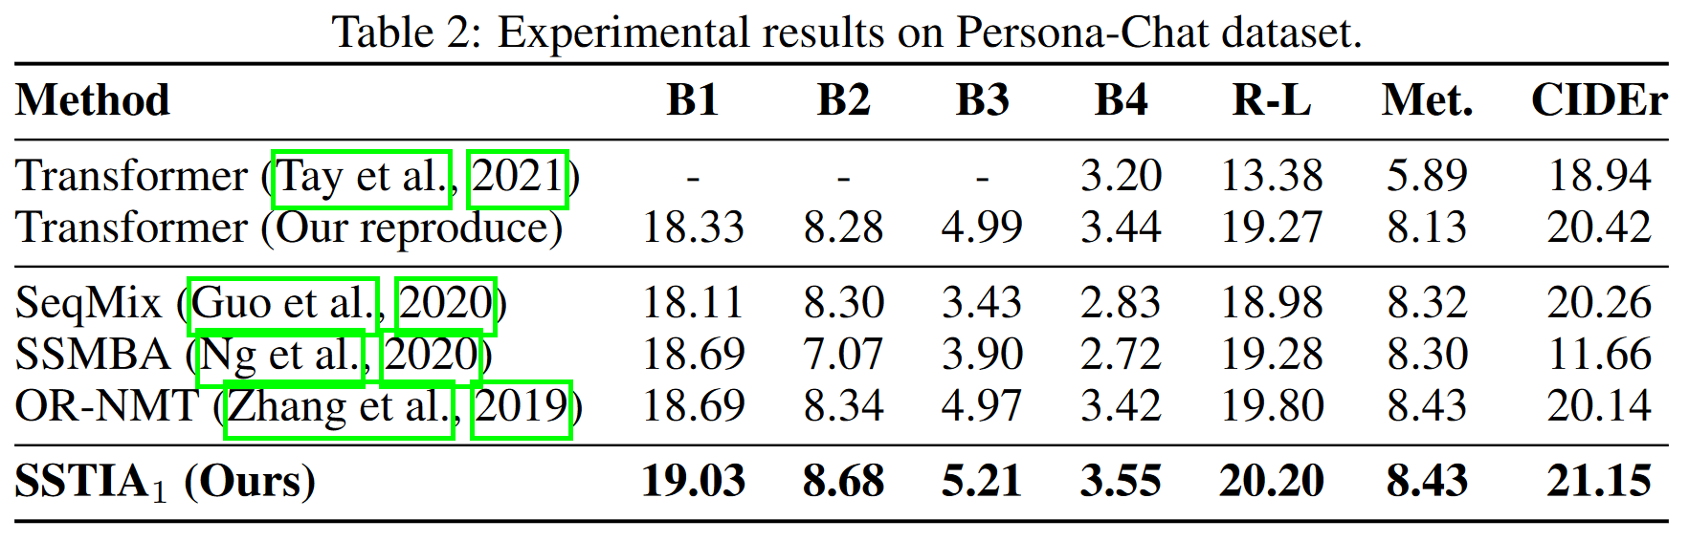
Experiments - Dialog Generation

Slide 6
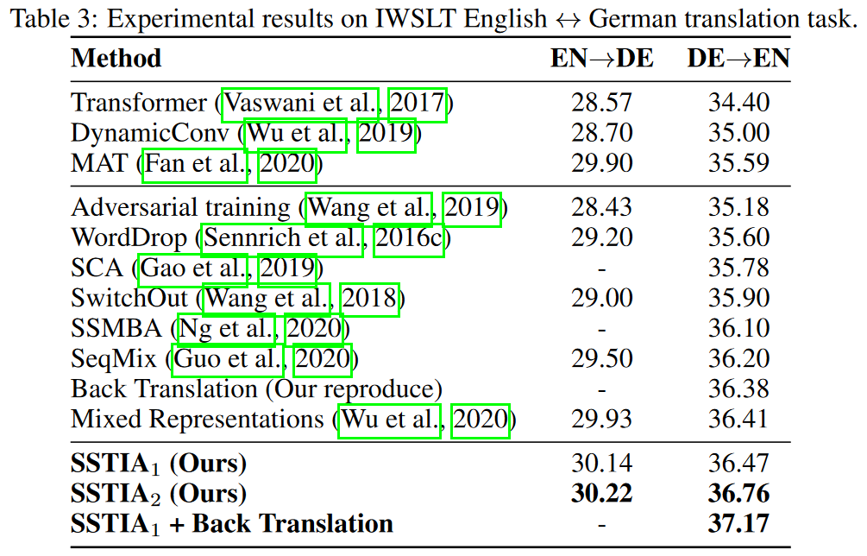
Experiments - Machine Translation

Slide 7
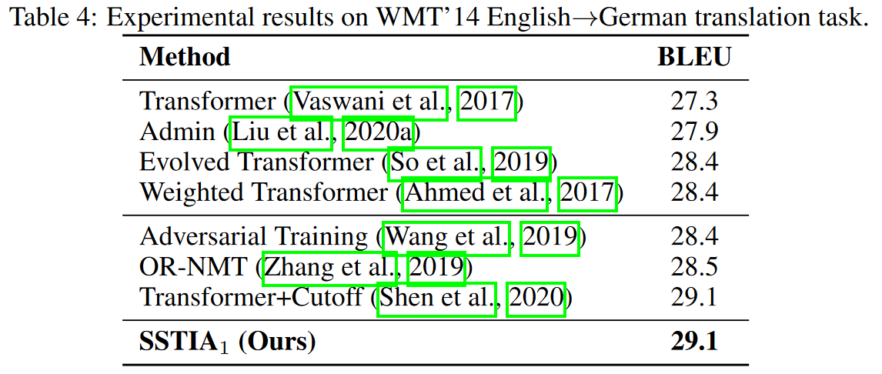
Experiments - Machine Translation

Slide 8
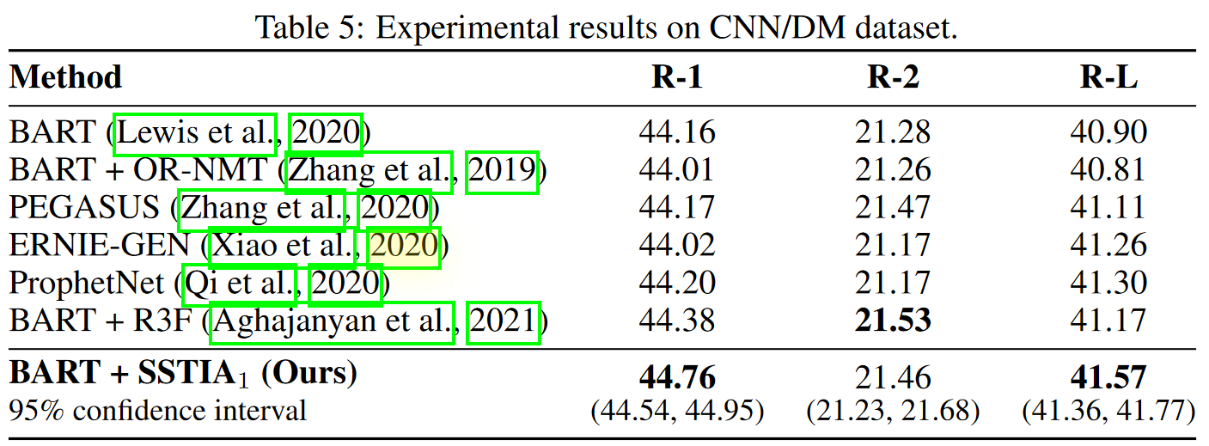
Experiments - Abstractive Summarization

Slide 9
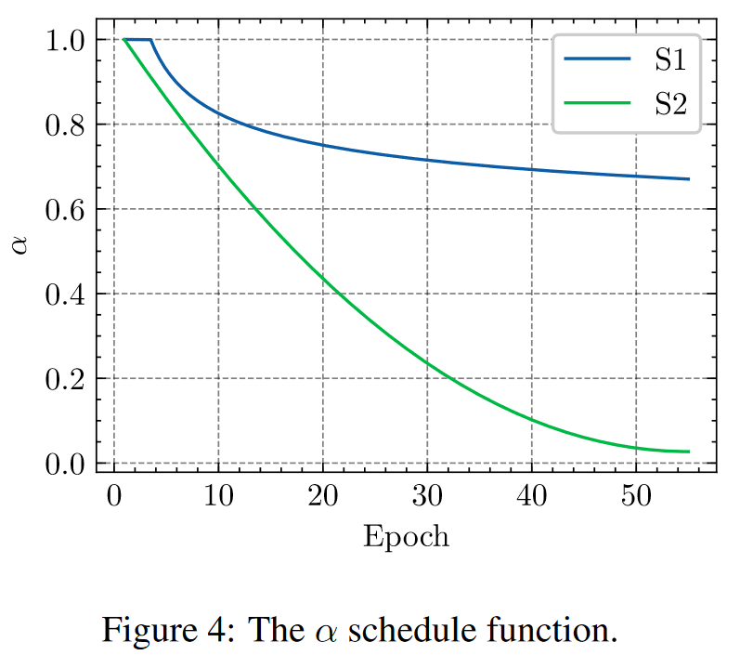
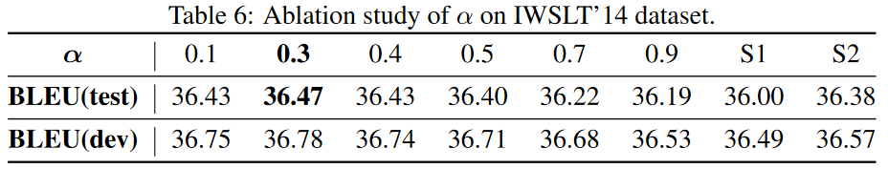
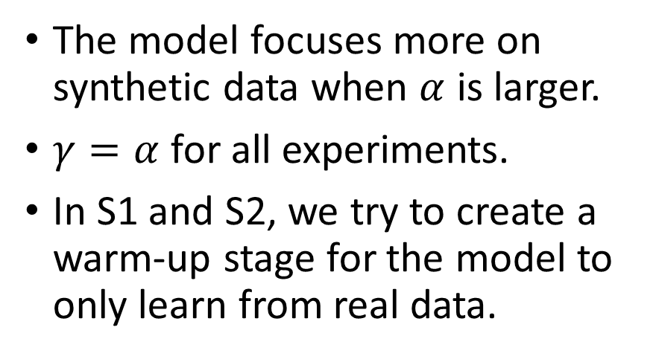

Ablation Study - $α$
The model focuses more on synthetic data when $α$ is larger.
$γ=α$ for all experiments.
In S1 and S2, we try to create a warm-up stage for the model to only learn from real data.

Slide 10
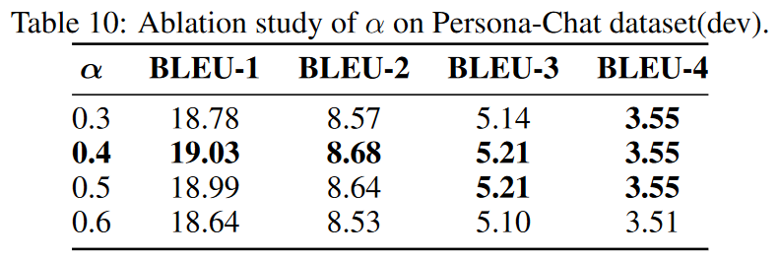
Ablation Study - $α$
The model focuses more on synthetic data when $α$ is larger.
$γ=α$ for all experiments.
In S1 and S2, we try to create a warm-up stage for the model to only learn from real data.

Slide 11
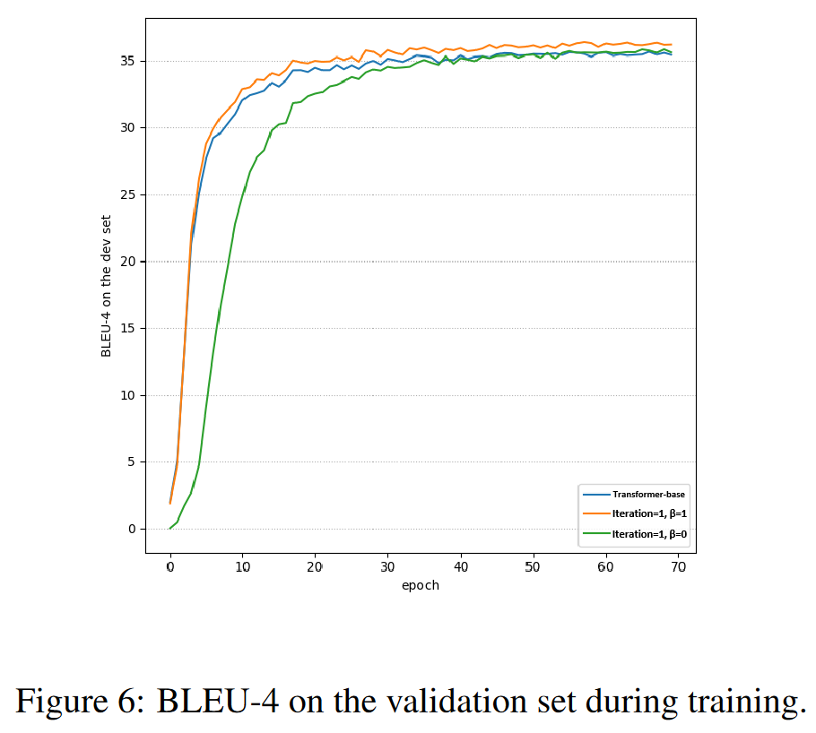
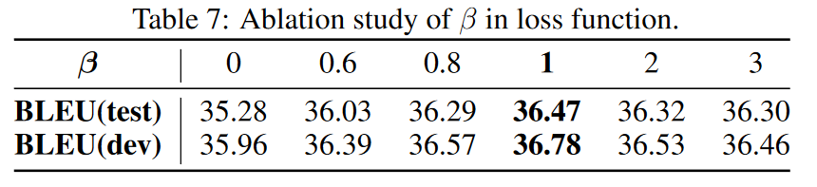

Ablation Study - $β$
We found that the consistency loss stabilizes the training.

Slide 12
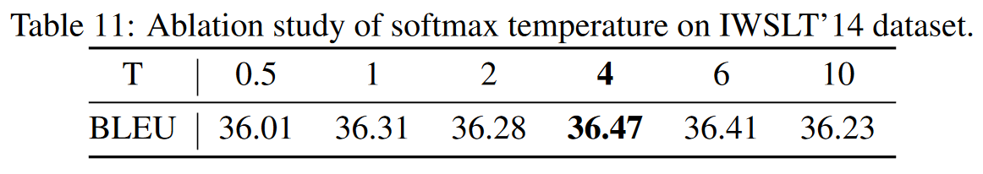
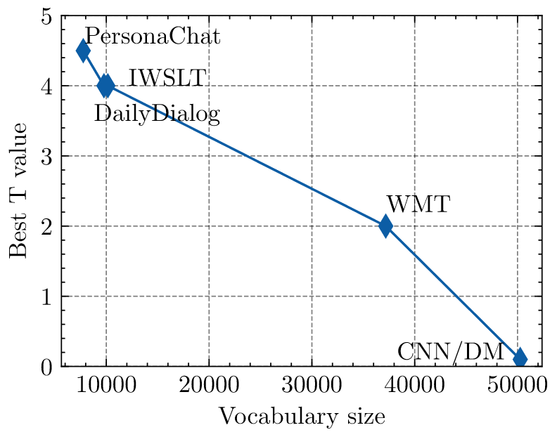
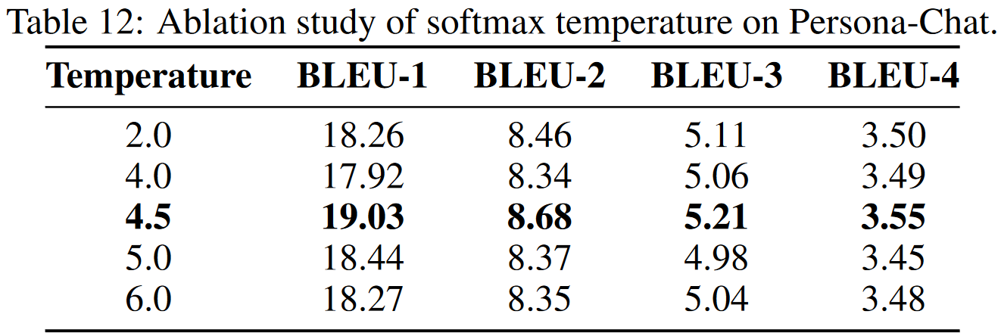


Ablation Study - $T$
${\breve{y}}_{j}≠γP\left(⋅|x,y_{<j}\right)+\left(1−γ\right)y_{j}=γsoftmax\left(logits\right)+\left(1−γ\right)y_{j}$;
${\breve{y}}_{j}=γsoftmax\left(logits/T\right)+\left(1−γ\right)y_{j}$.

Slide 13
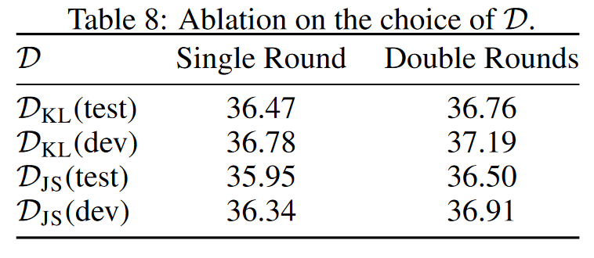

Ablation Study - $𝒟$

Slide 14
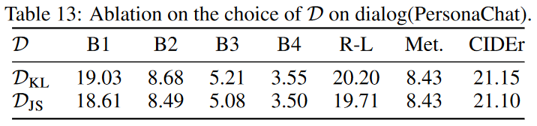
Ablation Study - $𝒟$

Slide 15
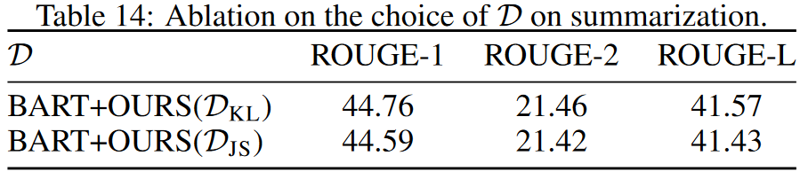
Ablation Study - $𝒟$

Slide 16
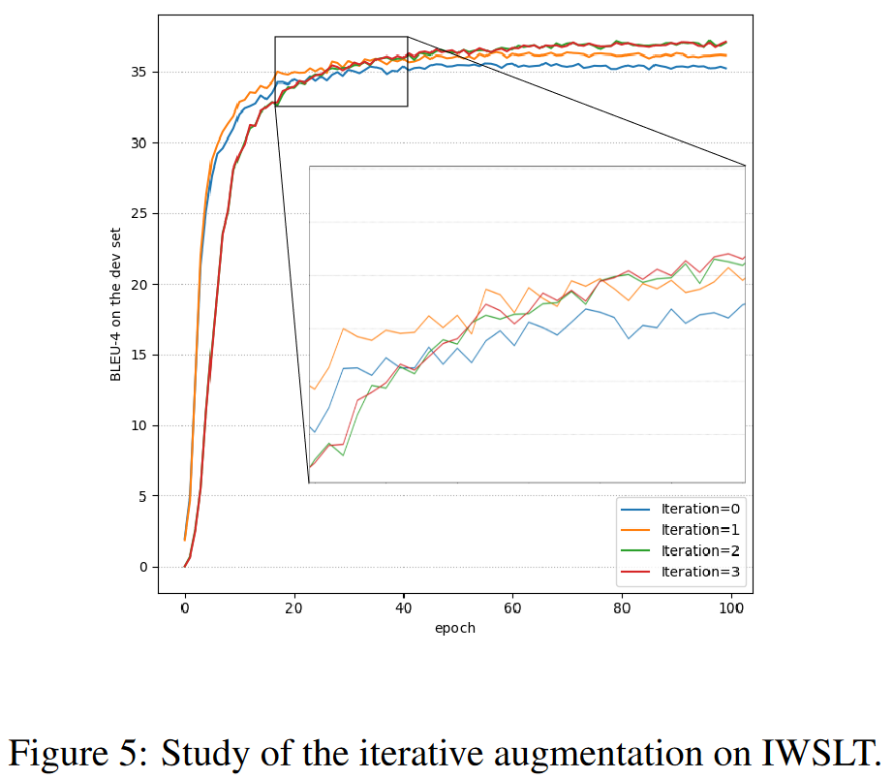
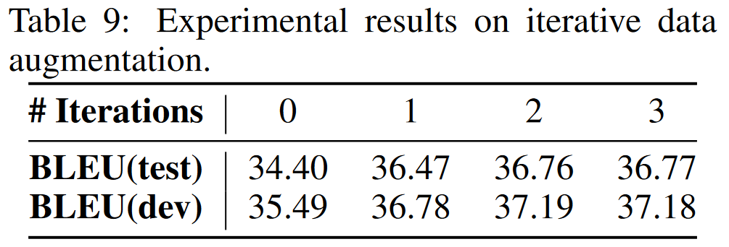
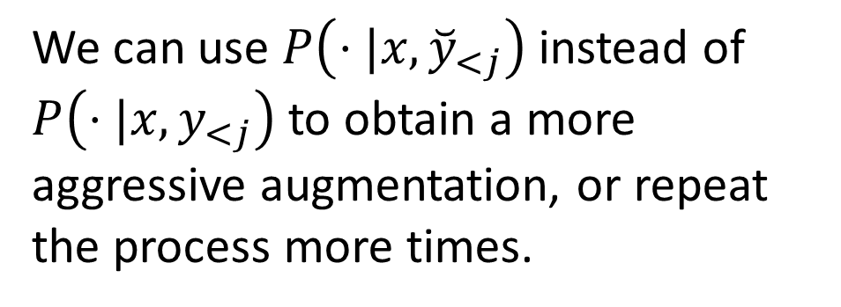
Ablation Study - Iterative data augmentation
We can use $P\left(⋅|x,{\breve{y}}_{<j}\right)$ instead of $P\left(⋅|x,y_{<j}\right)$ to obtain a more aggressive augmentation, or repeat the process more times.

Slide 17
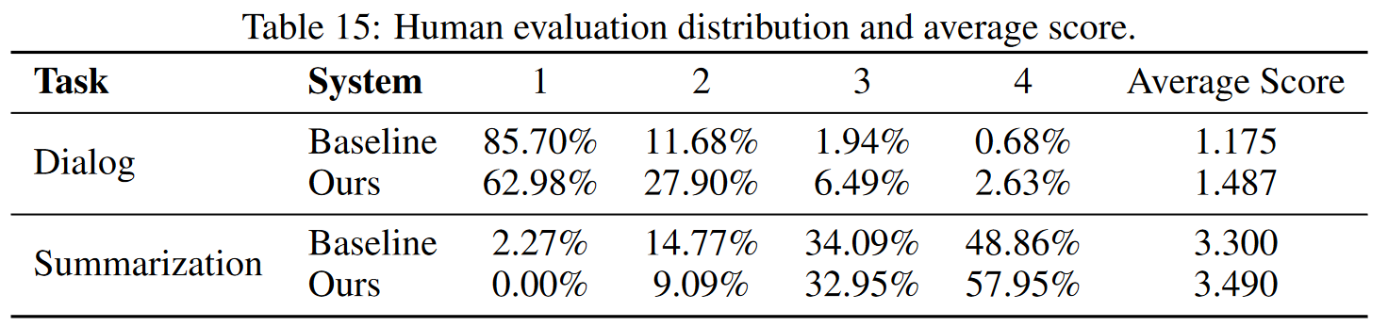
Human Evaluation

Slide 18
Ends.

